Slide 1

Data Visualization

Slide 2
Data Visualization

Slide 3

Process
Information
Perception
Notes:
Humans perceive information through a complex process. Anyone trying to visualize data should somehow use that process to make sure people comprehend it better and faster.
While complex, the fashion in which humans perceive information is orchestrated and some basic principles are known through research that help the field of data visualization tremendously.

Slide 4
Visual Encoding
“visual encoding is the way in which data is mapped into visual structures, upon which we build the images on a screen.”
Notes:
Basically, it is a mapping from data to display elements

Slide 5
Data Types
There are three basic data types:
Quantitative
Discreet
Continous
Qualitative
Categorical
Nominal data
Ordered/Ranked data
Notes:
Total population is a discreet, while income per person is continuous.
Nominal data is categorizing the data in to groups, like the geo-region coloring in Han’s work! We could have done this by numbering too, but what is the point of using numbers when they don’t have a mathematical meaning?

Slide 6
Visual Encoding Variables
There are two visual encoding variables
Planar (position)
Retinal
Notes:
Retinal Variables were introduced by Jacques Bertin (Author of: https://www.amazon.com/Semiology-Graphics-Diagrams-Networks-Maps/dp/1589482611/)

Slide 7
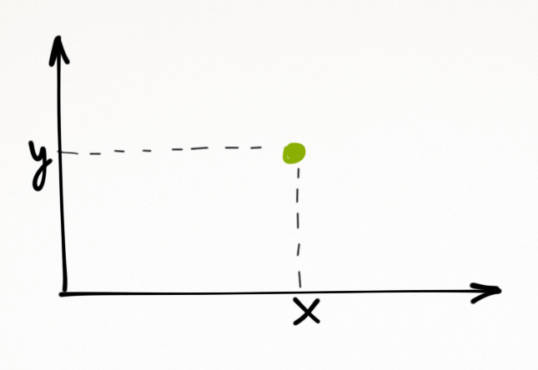
Planar Variables (Position)
One of the most prominent visual encodings
Simplicity of an x y plot
Works great with quantitative data
Good for two variables
Notes:
We perceive a ‘position’ with great accuracy. The eye doesn’t perceive the third dimension well. 3D models are perceived poorly because quantitative comparison between points is difficult.

Slide 8




(Thank God, for) Retinal Variables
Size
Texture
Shape
Orientation
Notes:
Size works very nicely with ordered data, In Han’s world DV, size represents the population of each country, combined with color, those countries really begin to stand out (India, US, China).

Slide 9

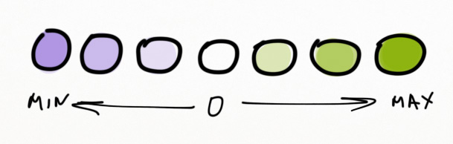

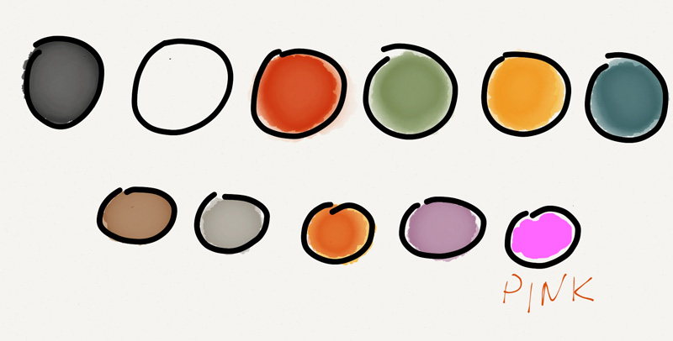
(Thank God, for) Retinal Variables
Color Hue
Diverging Scale
Color Value
Number of colors
Notes:
While it may be difficult to assess quantitative value through color hue, these are still all very good for ordered data.

Slide 10
Could an Orange Peel Cover a Banana…?
Q O C
Q: Quantitative
O: Ordered
C: Categorical

Slide 11
What about planar variables?
Q O C
They can be applied to all data types
Q: Quantitative
O: Ordered
C: Categorical

Slide 12
The Effectiveness of Display Elements
Robert McGill researched on how quantitative data was interpreted using different visual encodings and came up with ranking:
Position
Length
Angle | Slop (Orientation)
Area | Size
Volume
Color Hue | Color Saturation | Color Density

Slide 13
What is the most common analysis hung-up?

Slide 14
What makes an efficacious visualization?

Slide 15
How do you identify yourself?

Slide 16
What works as the greatest gain?

Slide 17
Computational Information Design Ben Fry (PhD. Thesis)
CS
Statistics/
Data
Mining
GD
Info Vis & HCI
Acquire
Parse
Filter
Mine
Represent
Refine
Interact

Slide 18
Difference between EDA and DV
Exploratory data analysis is the conversation between you and your data when you are not trying to prove anything to anyone
Data visualization is what you present to your audience

Slide 19
Let’s suppose
We have 4 datasets
Each data set has the same number of data points
The entire summary statistics across the datasets is the same
Mean
Variance
Correlation Co-eff
Line of best fit
Would these datasets look similar when visualized?

Slide 20
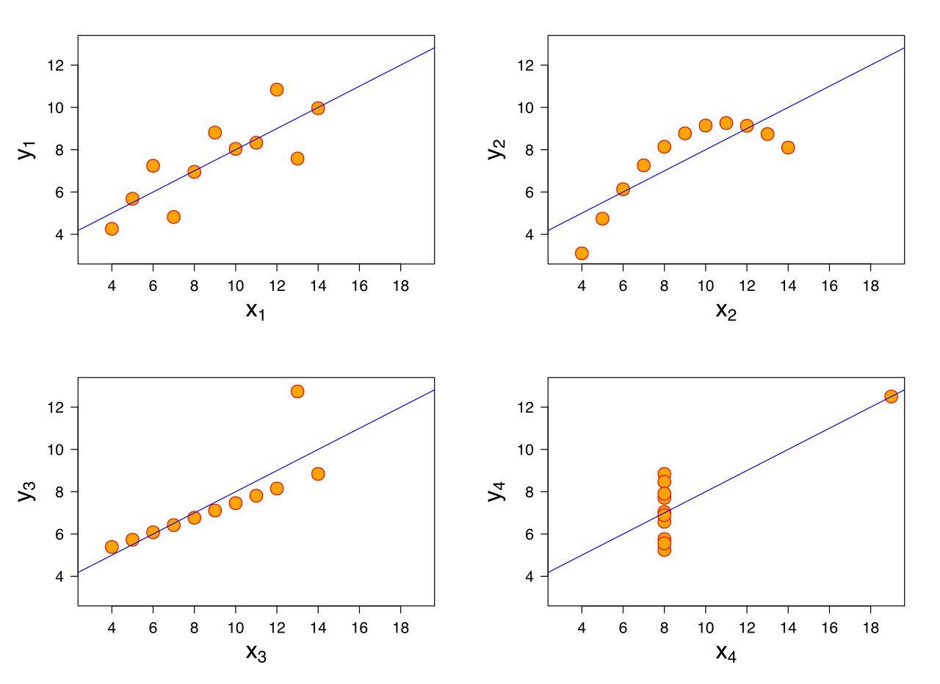
Anscombe’s Quartet by Frank Anscombe
Notes:
It is always important to plot the data. There are tools for this like matplotlib in python and ggplot in R to help you do that. The effect of curvature, outliers, etc, can really throw off your summary statistics. Plotting helps you with:
-identifying patterns
-picking trends
-spotting outliers

Slide 21
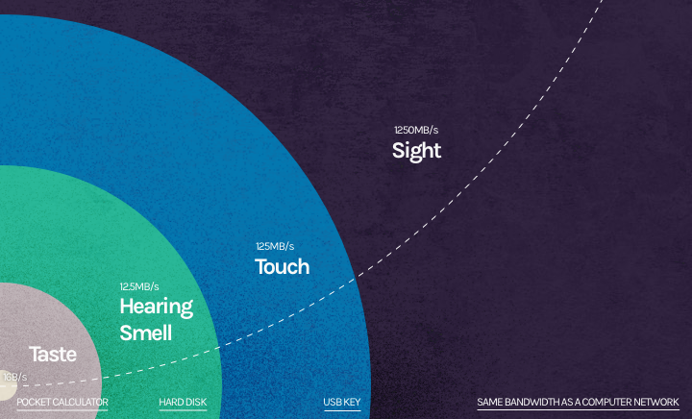
Bandwidth of Our Senses Denish Physicist: Tov Norretrander
Notes:
Source: https://wiredcraft.com/blog/data-visualizations-images/

Slide 22
Gapminder
The power of visualization: Hans Rosling Ted Talk 2006
Original visualization on Gapminder.
Notes:
https://www.ted.com/talks/hans_rosling_shows_the_best_stats_you_ve_ever_seen
Hans Rosling’s visualization is full of visual encodings. The top right quadrent shows high life expectancy and high income per person.
Gapminder was founded in Stockholm on February 25, 2005, by Ola Rosling, Anna Rosling Rönnlund and Hans Rosling

Slide 23
Decomposing Visualizations
What visual encodings are used?
What interactivity is provided?
Who is the intended audience?
Does shape encode any information?
What does opacity refer to?
What the EDA behind it?
What has been done to highlight the results?
What exactly has been replaced by animation?
Let’s try decomposing this example!
Notes:
http://www.nytimes.com/interactive/2012/05/17/business/dealbook/how-the-facebook-offering-compares.html
Built entirely on D3. Let’s decompose it to figure what visual encodings and elements were used, and what makes this chart so effective.
Prev and Next to see the whole narrative
Hover over circles to see more information about each company
Very effective title – quickest way to talk to your audience (says how facebook IPO compares to the IPO of other tech companies
Visual encodings used: size, shape, x position, y position, color, opacity
Some VEs encode the same information (double encoding) – Y position and Radius of circle. Double encoding adds emphasis, so what you are double encoding is actually important ☺
Likewise X position and color both encode the year – do you notice the color red and blue and hues of both in the center? That’s the diverging scale encoding we explored earlier
Does shape encode any information here?
Could shape have encoded any useful information here? Like the industry or vertical?
What does opacity refer to here? Does it help us see the relative distribution of data points? Concentrations, etc?
Is ‘animation’ a visual encoding? No but it is encoding the change of information in this case, for example in this case it tells us clearly how drastically Facebook’s IPO is in value compared to to the others!
What do you think the IRS found compelling during their EDA? Perhaps, that Facebook was the king as far as the IPO value was concerned
What is done to highlight the results? That would definetly be using different scaling, logarithmic in this case. A log scale makes graphics more interpretable.
Notice that animation here is doing for us what a z axis would have done. Is it not a whole lot better?

Slide 24
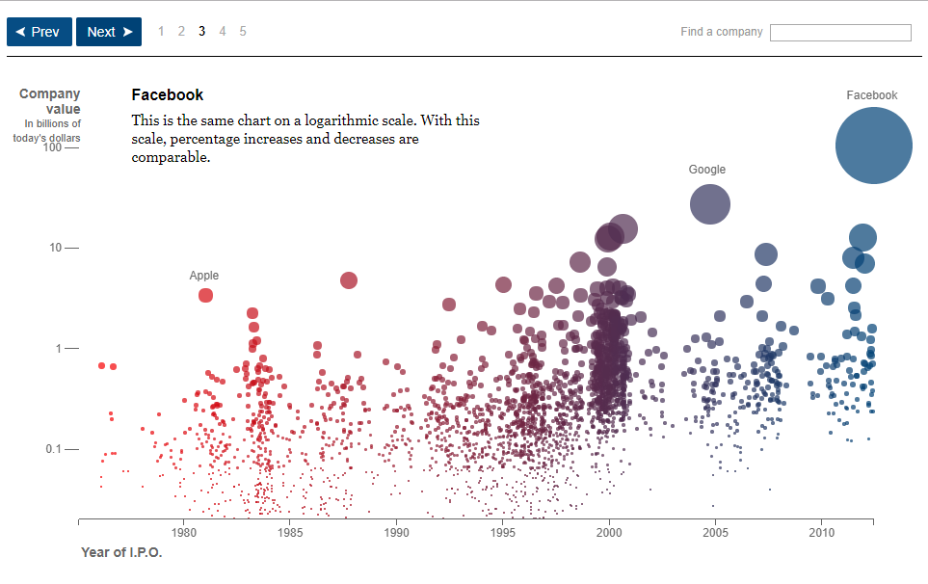

Slide 25
Relevant Tools
BI Tools
Suit of libraries built on D3
D3.js
SVG, Web GL, HTML5 Canvas
Productivity
D3.js is a client-side Javascript library
Flexibility
Notes:
What is a client-side JS library? Basically this means that you can load it on ANY webpage and start selecting different elements on that page and manipulate them.
SVG (Simple vector graphic), canvas etc are low level graphical specifications. These are extremely low lever
D3: Data vis library built atop of open web standards, implemented in JS. Allows seamless data binding to HTML and SVG elements. Since HTML is styled with CSS, well you know the drill!
D3 is pretty low level of abstraction (more like c/c++), so just like c/c++ are used for writing OSs, D3 is used to write further libraries on top of it. You can basically create a BI tool using D3.
We live in a lucky era because there are a whole suit of D3 libraries. Dimple, DC, Rickshaw, crossfilter etc are number of libraries built atop D3. Think of D3 as the Data Visualization Lego that you may use to build higher level abstractions
Knowing D3 gives you a lot of power. Just like using Ruby or Python does. Both of these are relatively high level languages, meaning they are interpreted languages, mostly programmed in C. So you don’t have to deal with memory collection, etc which you still have the power to go to the bare backbone if you intended to ☺
At the very top is the graphical interface, like RAW, Chartio etc.
D3 can interact with Python, Java and all the core web technologies.

Slide 26
Remember: Visualization phase of any Data Science project is a tradeoff between developed productivity and efficiency of your solution.
Libraries Built Atop D3
Charting
Libraries
Datatype Customized
Dimple.js, D3.js, etc.
Rickshaw.js, all the geo libraries, etc.

Slide 27
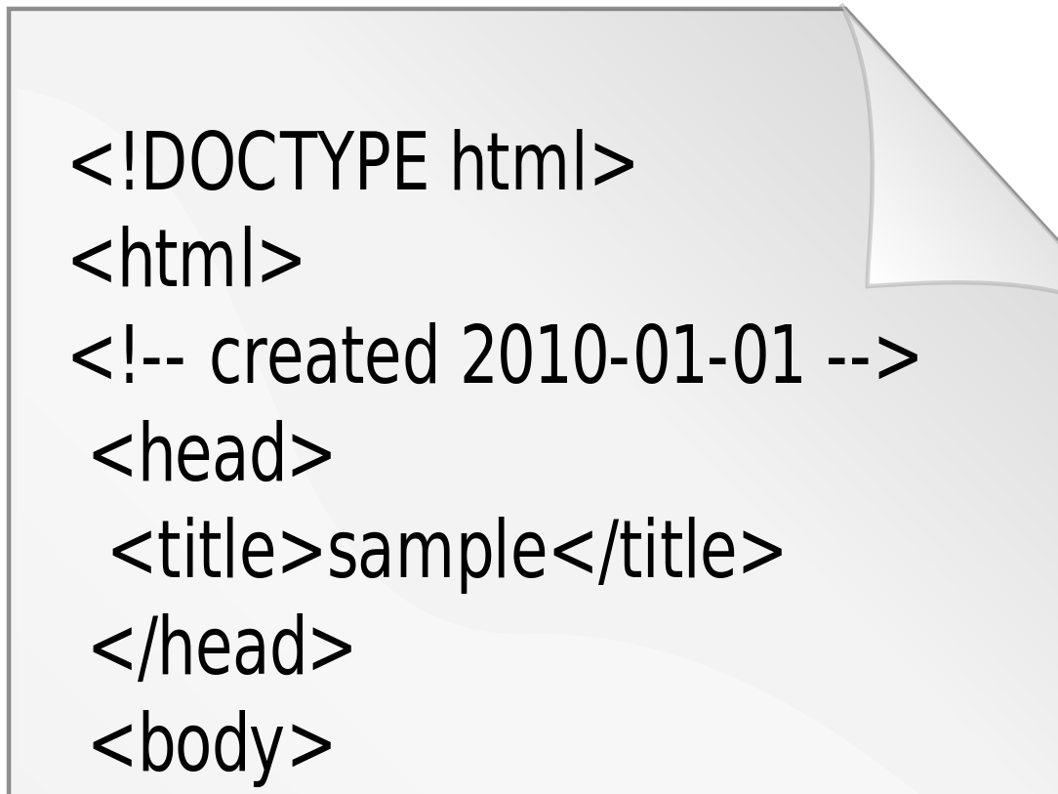
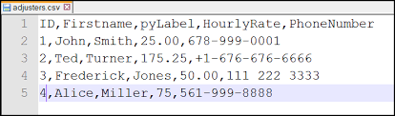
Understanding the Term: D3
Data
Driven
Documents
D3 binds Data to the Document
(Rows of JSON, CSV to SVG Elements)

Slide 28
Documents
Browser can be thought to have ‘views’ of a webpage
A web page’s original source code (HTML, CSS, JS, SVG, etc.)
DOM (Document Object Model): A specification much like HTML, that specifies a common programming interface for any HTML/XML document
Notes:
The original source code is what gets returned from the server.
The DOM is the parsed object.

Slide 29
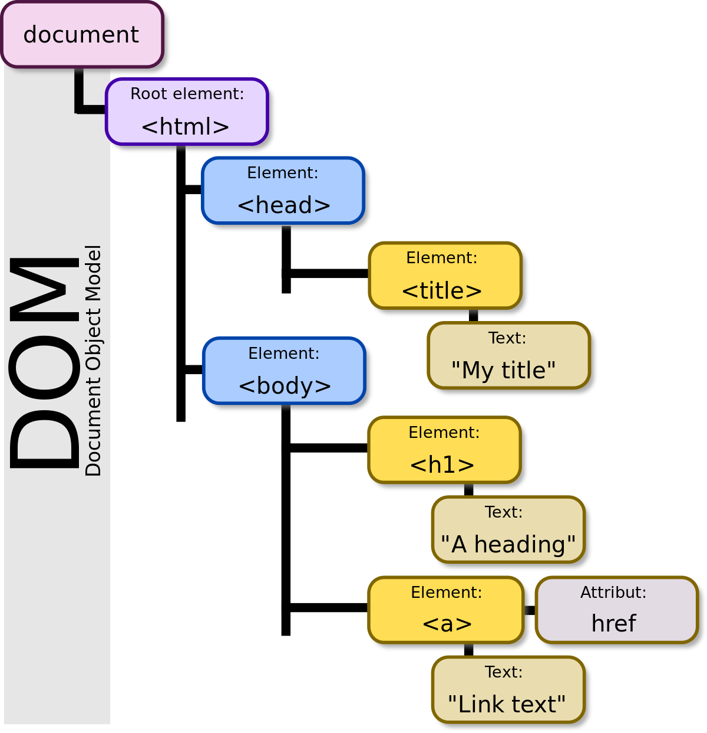
Notes:
Understand this from the factory example.

Slide 30
Client
Web Server
HTTP Request
Web browser parses
the file and transforms
it to a Heirarchical Object (DOM)
Response: source
D3 binds data to DOM, not to source or visual elements
Once binded, D3 drives the document
In this way it can create a chart based on the data that is in the DOM
Notes:
Important: Pre render HTML and SVG objects for a rather complex visualization on the server side and then simply use JS for any sort of interaction, animation or dynamics that we may require on the client side.

Slide 31
DOM Manipulation = D3, the Star!
Rather than obscuring DOM, D3 embraces it, allowing itself to:
Directly manipulate HTML nodes and SVG objects through common conventions like CSS selectors
Leverage existing technologies to enable the creation of extremely expressive visualizations
Enable designers and developers interaction by separating style from mechanics
Manipulate already created HTML documents
Benefit from advances in all browser technologies (HTML5)
Enable developers to work with the technology stack and libraries they are familiar with
Notes:
WHY ALL THIS FOCUS ON DOM. Well that is precisely what plays to the strength of D3.
Since D3 operate directly on DOM and SVG, what you make can be styled as any other webpage!

Slide 32
Lets start playing with D3
Go to your web browser
Open the Javascript Console
Windows: Ctrl+Shift+J
Mac: Cmd+Opt+J
Elements tab: HTML inspector allows us to see different DOM nodes
Notes:
Since D3.js is a client side JS liberary, this means that you can load it on ANY webpage and start selecting different elements on that page and manipulate them.

Slide 33
Different ways to load D3
Copy pasting the D3.js (library) code directly in the console – it is here: D3js.org/d3.v3.min.js
Alternatively, you can create and run the following script on the console:
var script = document.createElement('script');
script.type = 'text/javascript';
script.src = 'https://d3js.org/d3.v3.min.js';
document.head.appendChild(script);
Notes:
We created a variable called script, and created an element that would hold that tag. We then direct to set it to the source code of the D3 library (the same link through which copy pasted earlier). In the end, we add the script to the <head> element of our document.
Typically, your application dev file will reference this D3 script so that way you can make use of it in your application.

Slide 34
Verifying the Load
A reference to the D3.js library should be added to the <head> element of the DOM
The functions available in the D3 library should be available in the console
Notes:
Discuss why some pages would already have it.

Slide 35
Javascript Console: A complete JS Editor
Create a simple function
function hi(){
return "happy learning";
}
Notes:
Play around. Check out the elements, inspect them. Check out the source code. Understand the source of the entire page. Do a10+11 on the console. We now have complete access to the source code, console, DOM and the D3 library.

Slide 36
Document Selectors
D3.js makes a selection (or choose an item on a webpage) using the native DOM selection API
The DOM selection API gets exposed through the native Javascript
There are many selector functions (called css selectors)
document.getElementByID("footer");
document.querySelector(‘.main’);
Many libraries have selector functions that make this selection easier (for example jQuery)
D3 itself has many methods to select the DOM nodes
Notes:
When you are working with D3.js, you would often want to select elements on a page. You can do this either by element’s HTML tag, their class, or ID.

Slide 37
D3 Selection: Return a DOM Node Vs. D3 Node
We can run the D3 functions on a D3 node, not a DOM node
Take a look at the core D3 functions to use for selection – best way to learn!
Multiple chaining mechanism of D3
Be careful when selecting by class names
D3.select(‘.footer’).style(‘background’,’black’);
D3.selectAll(‘img’);
d3.select('.homebox').text('D3');
d3.select('.box').html(null);

Slide 38
Recreating the Facebook IPO Circle
d3.select('.main').html(null);
var svg = d3.select('.main').append('svg');
var y = d3.scale.log().domain([10000,1000000000]).range([150,0]);
var x = d3.scale.linear().domain([0,40]).range([0,300]);
var r = d3.scale.sqrt().domain([0,500000000]).range([0,15]);
console.log(y(100000000),x(37),r(1000000));
svg.append('circle').attr('r',r(1000000000)).attr('fill','blue').attr('cx',x(37)).attr('cy',y(100000000));

Slide 39
Building a Dashboard

Slide 40
Dashboard Boiler Plate and Resources:
https://drive.google.com/drive/folders/0Bw9Oswa_kIqUbmFzMVhBdkgxNmc?usp=sharing

Slide 41
How to Choose a Chart Type?
Chart Type = Visual Encodings + Data Type + Relationship
Priority should be solving a problem – use a chart that best represents your data
What is the data type?
What is the dimension?
What relationship are we trying to convey between different variables
Are we comparing two variables?
Are we trying to show how one variable is distributed?
Huge but finite number of most commonly used chart types
Flowchart by Andrew Abela

Slide 42
What chart would you choose if…
We are trying to see the distribution in a 1D data?
A histogram (continuous)
bar chart (categorical)
We need to show a correlation between two variables?
Scatter plot!
Bubble plot (to show a third dimension)
We need to show comparison of distribution?
Box plot (John Tukey)
Small multiples (Edward Tufte)
Notes:
Both box plot and small multiples represent distribution of multiple variables side by side, very intuitive. They are both used extensively in EDA to learn how the data is dristributed

Slide 43
Understand the Client-Server Model
Localhost (WAMP, or any other), or any other web server
Corresponds to the host or server from which the file was loaded
We will be using localhost (the current machine)
Port 80
The application and the files associated to it

Slide 44
Client
Web Server
HTTP Request
D3js.org:80
Web browser parses
the file and transforms
it to a Heirarchical Object (DOM)
An external loading function, like “data.json” is encountered
The browser can now create the visualization.
Callback function executes
Response: source
Index.html
(JS, CSS, HTML, D3)
There is obviously a chart here that needs to render
An Ajax request reaches
The requested data could be present either on the same or another server. Response is created.
Ajax Request
Auto created
Browser waits
Response: data
Notes:
Important: Pre render HTML and SVG objects for a rather complex visualization on the server side and then simply use JS for any sort of interaction, animation or dynamics that we may require on the client side.

Slide 45
Data
http://www.vacommunity.org/VAST+Challenge+2017
The Boonsong Lekagul Nature Preserve is used by local residents and tourists for day-trips, overnight camping or sometimes just passing through to access main thoroughfares on the opposite sides of the preserve. The entrance booths of the preserve are monitored in order to generate revenue as well as monitor usage. Vehicles entering and exiting the preserve must pay a fee based on their number of axles (personal auto, recreational trailer, semi-trailer, etc.). This generates a data stream with entry/exit timestamps and vehicle type. There are also other locations in the part that register traffic passing through. While hiking through the various parts of the preserve, Mitch has noticed some odd behaviors of vehicles that he doesn’t think are consistent with the kinds of park visitors he would expect. If there were some way that Mitch could analyze the behaviors of vehicles through the park over time, this may assist him in his investigations.

Slide 46
Way Forward
Get familiar with the basic web technologies
Keep exploring the APIs for the libraries – fastest way to learn!
Follow Mike Bostock’s tutorials – he created D3 ☺
Keep hunting for expressive and effective visualizations
Always load already written code and try tweaking it
Beware of Javascript frustrations, and well, choose not to get frustrated!

Slide 47
Remember to sometimes think beyond dashboards and charts.
Play
Thank you!

